Slide 1
Software Construction Laboratory CS35L – Lab 1
Course Webpage: https://web.cs.ucla.edu/classes/fall18/cs35L/index.html
TA: Zhiyi Zhang
Email: zhiyi@cs.ucla.edu
Webpage: https://zhiyi-zhang.com

Slide 2
Session 1-2
Basics of Linux OS
Try Emacs

Slide 3
Follow up
Hard link v.s. Soft/Symbolic link
Process and file
chmod command to manage the access to your files
man command to read manual page of your command
How to manage the user/group in your Linux OS?
How to manage processes in your Linux OS?
How to read manual page?

Slide 4
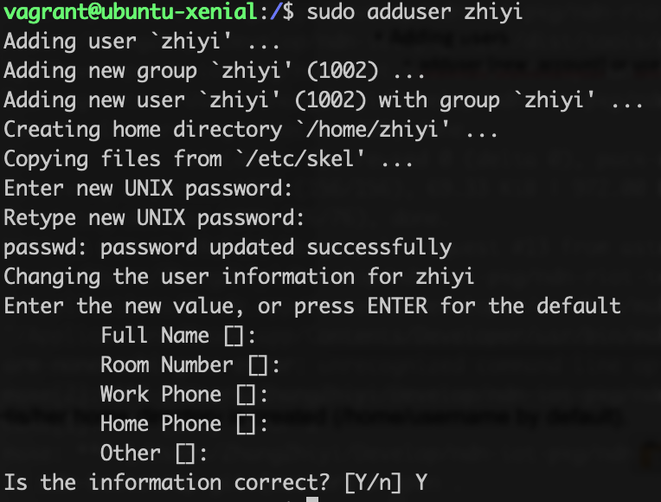
User/Group Management in Linux OS
Manage users
Adding a user: adduser [new_account] or useradd [new_account]
Editing user attributes: usermod
Remove a user: userdel –remove [user]
Manage groups
Adding a group: groupadd
Adding a user to a group: usermod
Remove a group: groupdel
Notes:
1. His/her home directory is created (/home/username by default).
2. A group is created and given the same name as the new user account.
3. The following hidden files are copied into the user’s home directory, and will be used to provide environment variables for his/her user session.
.bash_logout .bash_profile .bashrc

Slide 5
Learn man page sections
First Line: command (number)
Shows what section of the man page you are viewing
Man page sections are: (man man)
1 Executable programs or shell commands
2 System calls (functions provided by the kernel)
3 Library calls (functions within program libraries)
4 Special files (usually found in /dev)
5 File formats and conventions eg /etc/passwd
6 Games
7 Miscellaneous (including macro packages and conventions), e.g. man(7), groff(7)
8 System administration commands (usually only for root)
9 Kernel routines [Non standard]
Notes:
Read is both a command and a system call

Slide 6
Reading man Pages: Standard Headings
Name: name of the command followed by a short description of what the command does
usually one sentence or less
Synopsis: describes how the command is supposed to be used. Example: ls [Option]…[File]…
Description: gives a more detailed definition of the command and provides the OPTIONs available for the command.

Slide 7
Reading man Pages: Other Common Headings
AUTHORS: the people who created or assisted in the creation of the command.
BUGS: lists any known defects or shortcoming of the programs.
EXAMPLES or NOTES: An illustration of how to use the command including general notes.
REPORTING BUGS: where you should report problems you’re having with the command.
COPYRIGHT: The person or organization that holds the copyright to this information; usually a disclaimer that this is free software.
SEE ALSO: Other commands that are related to this command. This section also frequently mentions any other documentation related to this command.

Slide 8
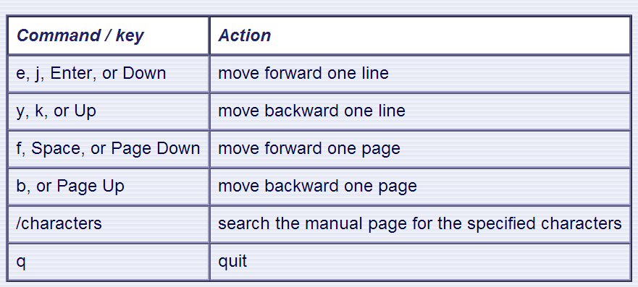
Moving Around in man Page
Use the following keys and commands to move around in the manual page:

Slide 9
Special Permissions in chmod command
sticky bit (o+t)
On shared directories, it locks files within the directory from being modified/deleted by users other than the file creator, owner of the directory, or root, even if others have write permissions
setuid, setgid (u+s, g+s)
“set user ID upon execution”
Run an executable with the permissions of the executable’s owner or group

Slide 10
Process Management with ps and kill
Process
An instance of a computer program in execution
ps
List processes that are currently running
kill
Terminate a certain process
Usage
kill PID

Slide 11
About Daemon
A process that runs in the background
Example: cron
Enables users to schedule jobs to run periodically at certain times (cron jobs)
Usage: Full Backup every month
Notes:
Cron is a daemon used to schedule any kind of task you can imagine. It is useful to send out emails on system or program statistics, do regular system maintenance, make backups, or do any task you can think of. There are similar programs on other Operating Systems. On Mac OS X, cron has been replaced with another daemon called launchd. On Windows you have the aptly named “Task Scheduler”. If you are craving a GUI for Linux, Gnome-based systems like Ubuntu, include Gnome Schedule which acts as a nice front end for cron.

Slide 12
diff command
A file comparison utility that outputs the differences between two files.
Shows the changes between one version of a file and a former version of the same file
Usage
diff original_file new_file
diff –u original_file new_file

Slide 13
wget command
A computer program that retrieves content from web servers
Usage
wget <URL>

Slide 14
Try Emacs
“The customizable, extensible, self documenting, real-time display editor”
Customizable (no programming)
Users can customize font, colors, etc. in ~/.emacs
Extensible (programming required)
Run Lisp scripts to define new commands (dired)
Self-documenting
C-h r (manual) and C-h t (tutorial)
Real-time
Edits are displayed onscreen as they occur
Notes:
Development of the first Emacs began in the mid-1970s, and work on its direct descendant, GNU Emacs, continues actively as of 2018.
Emacs is, along with vi, one of the two main contenders in the traditional editor wars of Unix culture. Emacs is among the oldest free & open source projects still under development.
With Emacs you are expected to have it open 24/7 and live inside the program, almost everything you do can be done from there. You write your own extensions, use it for note-taking, organization, games, programming, shell access, file access, listening to music, web browsing. It takes weeks and weeks till you will be happy with it and then you will learn new stuff all the time. You will be annoyed when you don't have access to it and constantly change your config. You won't be able to use other peoples emacs versions easily and it won't just be installed. It uses Lisp, which is great. You can make it into anything you want it to be. (anything, at all)
With Vim, it's almost always pre-installed. It's fast. You open up a file do a quick edit and then quit. You can work with the basic setup if you are on someone else's machine. It's not quite so editable, but it's still far better than most text editors. It recognizes that most of the time you are reading/editing not typing and makes that portion faster. You don't suffer from emacs pinkie. It's not so infuriating. It's easier to learn.

Slide 15
Best way to learn Emacs
Follow the tutorial
C-h t
Use it everyday :D
Some tips
Print the reference cards and stick them onto your desk/wall

Slide 16
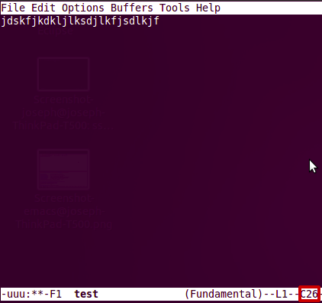
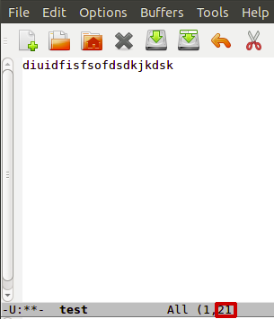
Getting Started
Install emacs
Should be installed already
Emacs has both GUI and CLI
All emacs commands start with “C” or “M”
“C” = ctrl; “M” = alt (Windows) / option(Mac)
Starting emacs
emacs <filename>
Exiting emacs
C-x C-c

Slide 17
Basic Editing
Insert text by simply typing it
Undo by typing C-x u
Save changes by typing C-x C-s
Copy, cut, paste
M-w (copy), C-w (kill), C-y (yank)
Command repetition
M-# <command> (M-2 C-n or M-5 C-f)

Slide 18
Directory edit (dired) (C-x d)
Creates an Emacs buffer containing list of dir
Allows you to operate on files
remove, rename, encrypt, decrypt, edit
Allows you to navigate filesystem
Switch to different directories and list content

Slide 19
Other Emacs Tricks…
Emacs as shell
Run shell commands
M-! <command>, M-x shell (interactive shell)
Emacs as IDE
Compile programs
M-x compile, then specify command to compile
Tip for homework: gcc hello.c –o hello
Run the executable by running the shell command
./hello

Slide 20
Column Number Check
Emacs editor
M-x column-number-mode
Options → Show/Hide → Check “Column Numbers”
The number inside the box is the Column Number.

Slide 21
80-Column Restriction in emacs
Add the following line to ~/.emacs
(setq-default fill-column 80)
Open your text file
Turn on AutoFill mode
“M-x auto-fill-mode” or
press “M-q” to auto wrap each paragraph

Slide 22
Assignment 1
Hints for first 10 questions:
man man
which
find
readlink
man chmod
man find
find
whereis, man find
find, sort
localedef

Slide 23
Assignment 1 – Example ans1.txt
ans1.txt is specifically for LABORATORY section
1. Here is the answer to question 1
2. Here is the answer to question 2
3. Here is the answer to question 3
…..

Slide 24
Assignment 1 – Example key1.txt
key1.txt is specifically for HOMEWORK section
C-s H E L L O W O R L D
C-s H T M L
C-d
C-n
M-x goto-line Enter 1 2 3 Enter
Notes:
$ whatis which which (1) - shows the full path of (shell) commands $ whatis whereis whereis (1) - locate the binary, source, and manual page files for a command

